Slide 1


Connection 5G – Scenario
Copyright © 2022 Adobe. All Rights Reserved.

Slide 2
Connection 5G: Business Primer
Key Strategic Initiatives
Unlock New Opportunities: Continue to drive new customer acquisition and retention but win back lost customers and cross-sell, suppress to save money
Hyper-Personalization: Deliver engaging content through relevant, tailored personalized experiences.
Increase ROI on Customer Data: Move towards a unified view of customer by consolidating disparate views of customer accounts, standardize data usage and privacy workflows.
Cost Optimization: Reduce operational costs via increased speed, scale and flexibility
Notes:
validate their data and enforce security policies for data usage workflows to add value to the business and secure the privacy of their customers.

Slide 3



Customer Use Cases
Journey optimizer
Real-Time CdP (Acquisition)
Real-Time CdP (Upsell)
Orchestrate the curb-side / in-store pickup communication process starting from when an order is placed to when an order has been picked up
Activate all profiles who have visited an iPhone 13/Pixel 6 product page and no order exists for that device or that device is not currently an active line on the customer’s account
Find all profiles who have a total billing data usage in the last 6 months > 140 GB, have a rolling 6-month average monthly data usage >= 20 GB and are not on the ultimate phone plan

Slide 4
Customer Use Cases – Phase 1 Focus
Journey optimizer
Real-Time CdP (Acquisition)
Real-Time CdP (Upsell)
Orchestrate the curb-side / in-store pickup communication process starting from when an order is placed to when an order has been picked up
Activate all profiles who have visited an iPhone 13/Pixel 6 product page and no order exists for that device or that device is not currently an active line on the customer’s account
Find all profiles who have a total billing data usage in the last 6 months > 140 GB, have a rolling 6-month average monthly data usage >= 20 GB and are not on the ultimate phone plan

Slide 5
Connection 5G: System Description
Centralized data warehouse in Teradata used to unify all customer data but currently lacks many of the marketing application feedback loops
Commerce system fully integrated with CI/CD pipeline but requires IT effort to exposes new events to the business requests
Google Analytics deployment exists but primarily used to understand basic page traffic. Significant interest with gaining access to the data set and feed it back to their warehouse for data science and analysis.
Billing system is a batch based daily job that pushes to warehouse but there are plans to integrate it into the CI/CID pipeline over the long term
IVR system currently works off a projection of data from the warehouse but there is need to make data more accessible to the call center to deliver more contextualized conversations / offers
Salesforce being leveraged by marketing to send email, SMS and mobile communications to customers. Significant investment by marketing into this application but currently heavily batch-based feeds with data coming from the warehouse
Notes:
validate their data and enforce security policies for data usage workflows to add value to the business and secure the privacy of their customers.
Connection 5G Journey Activation includes manually stitching the Journey vs. a coordinated real-time effort. The biggest problem they are facing is that they do not have single source of truth and do not have have a consolidated unified profile.
They have one platform for the marketing org to create journey for B2C and B2B use cases. They have challenges with incorporating Next Best Action in customer journey in real time at scale across all channels. Currently their data quality, transparency and validation are lacking. There is no consistency of data utilization or scale and flexibility. This makes it hard for data availability to inform messaging.

Slide 6
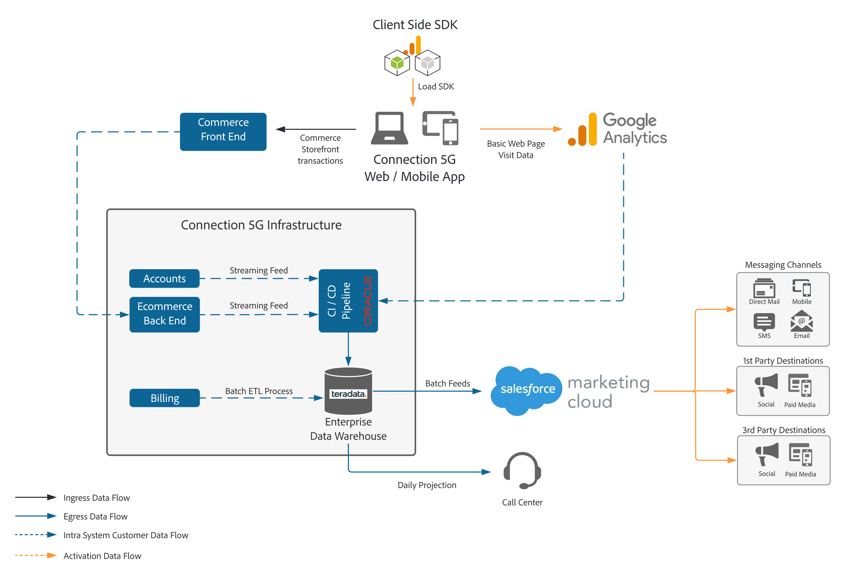
Customer Architecture: System View
Lack of onsite personalization given no existing architecture is available to expose the warehouse data in a consistent fashion for marketing to leverage
Scalability & reliability are a concern as IT teams are constantly being asked to expose the data within the warehouse to the various marketing applications within the marketing stack. Long term to plans to re-architect the warehouse and move to Redshift or Snowflake
Data Governance & privacy are key priorities with all systems moving forward. Need to centralize all governance and privacy for internal teams and marketing teams when working with the customer data

Slide 7
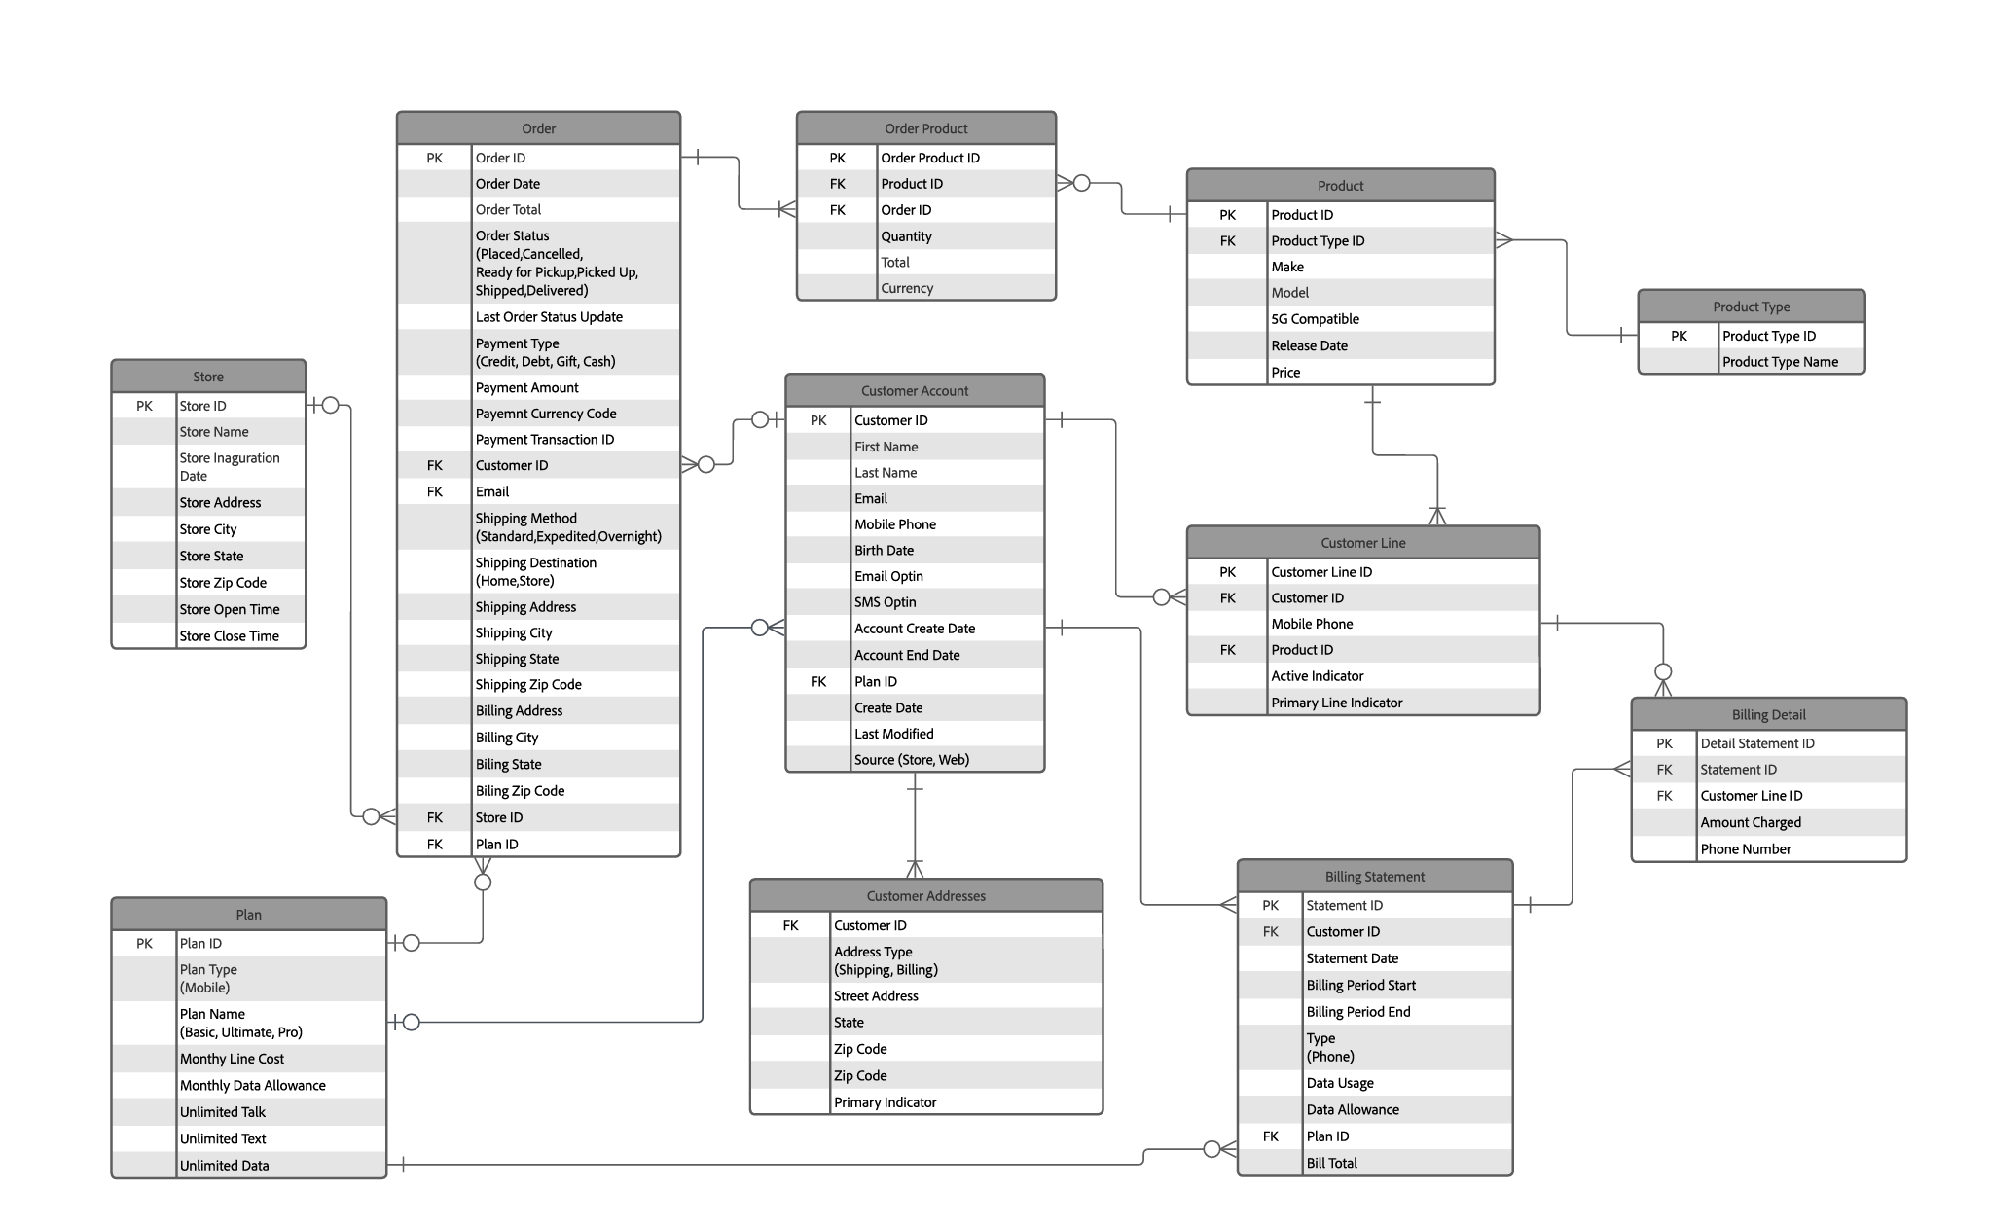
Customer Data Architecture: Warehouse View

Slide 8
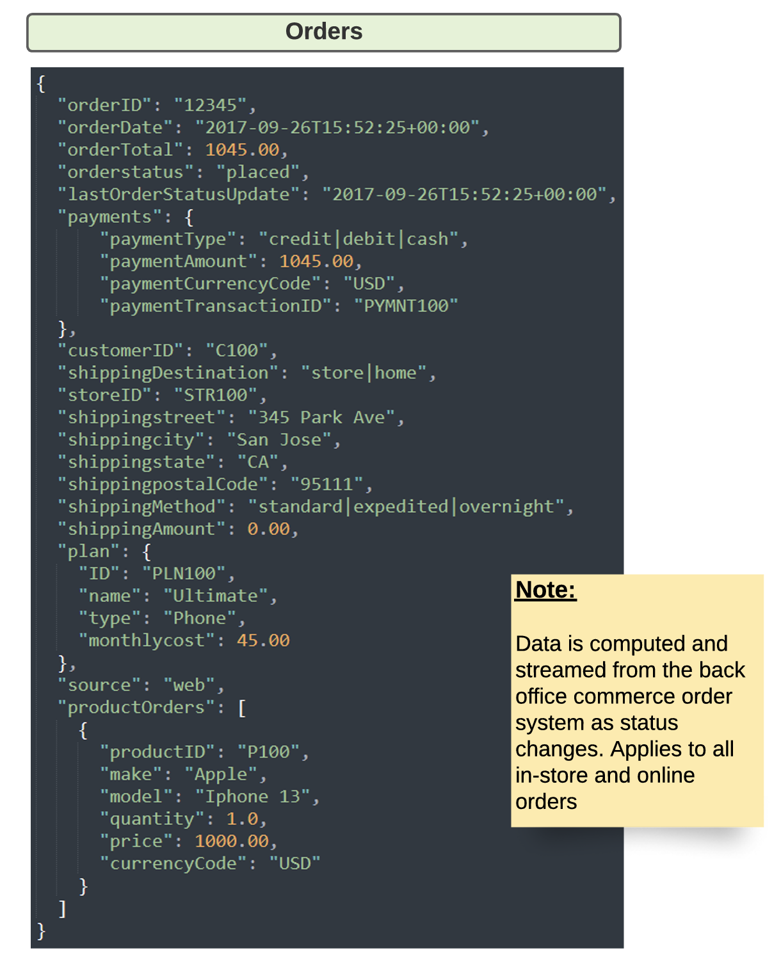
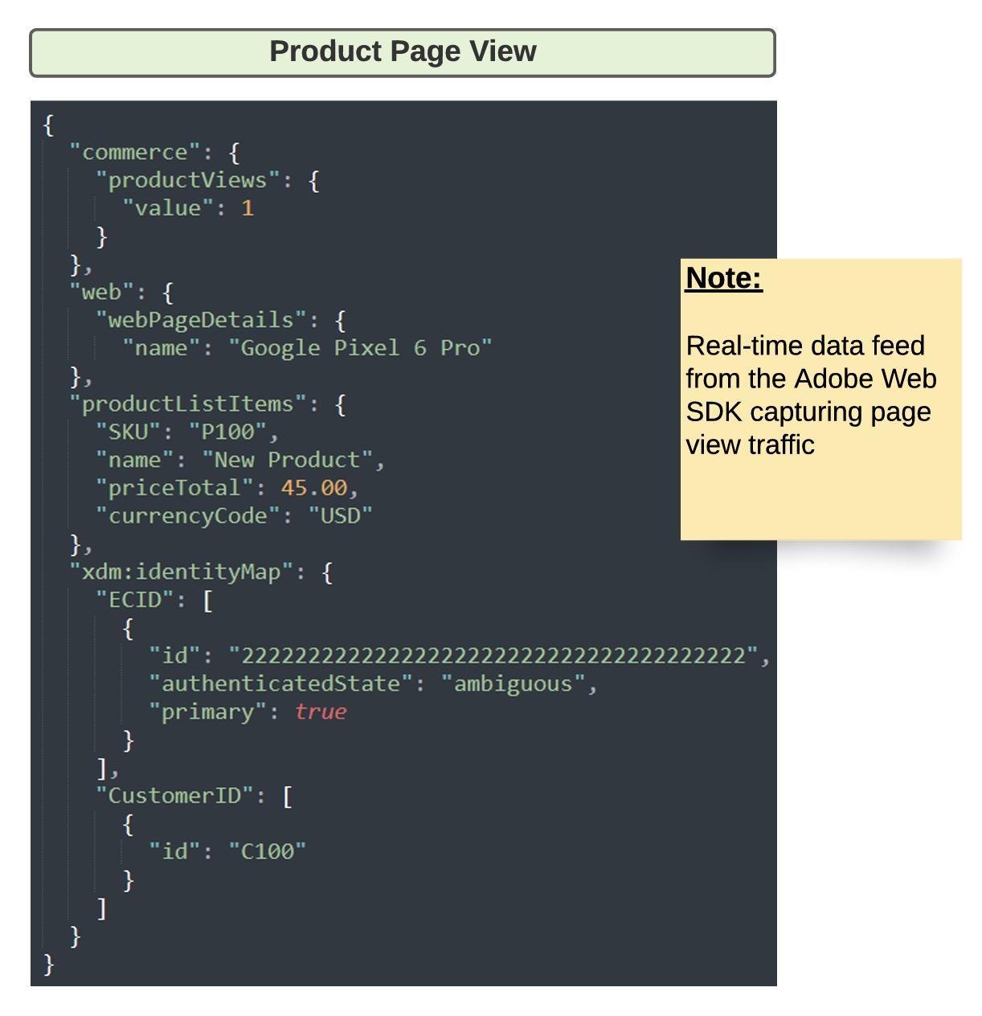
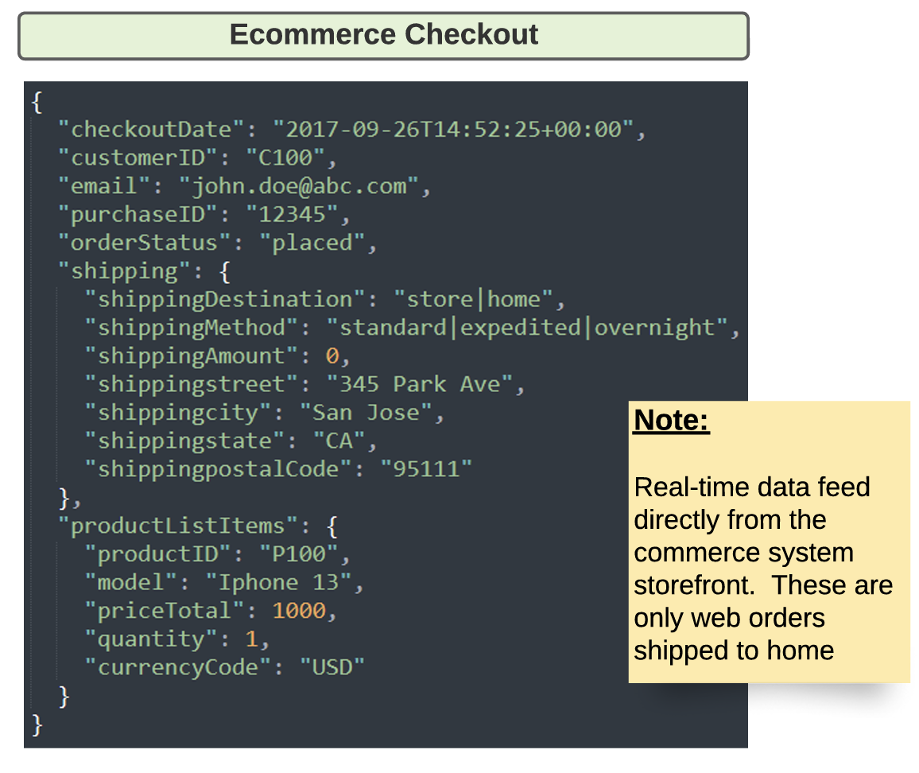
Customer Data Architecture: Streaming Payloads

Slide 9
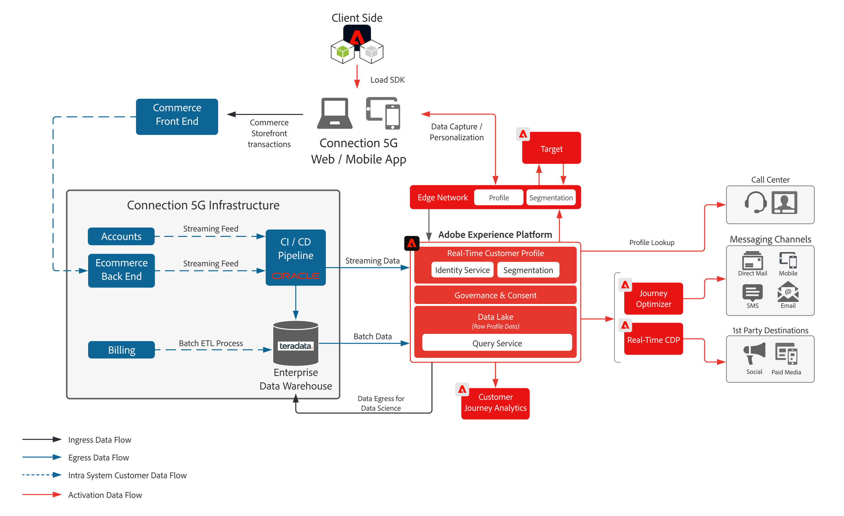
Proposed North Star Architecture

Slide 10
Proposed Phase 1 Architecture

